Slide 1
Georgia Power’s Strategic Overhead-to-Underground Conversions
Robert Reepe III, PE
Principal Engineer, Power Delivery Systems and Standards
Georgia Power Company, Atlanta GA
NEETRAC Management Board Forum, Atlanta GA
1/23/2020
1

Slide 2
Utility Facts and Historical Reliability Improvements
2.5 M customers in 155 of 159 counties in GA
76k miles of distribution lines
2600 + distribution feeders
Historical reliability improvements were made on the bottom ranked feeders (ranked by SAIDI and SAIFI)
Improvements were spot improvements and budget only allowed for maintenance of Company wide SAIDI and SAIFI
New focus has been on improvement of chronic worst performing feeders and substations, improvement of Company wide SAIDI and SAIFI
  Improvements include targeted overhead-to-underground conversions
  Divide feeders into 500 or 300 customer count segments for restoration
Notes:
500 count segments = urban
300 count segments = rural

Slide 3
Mystery Valley
4 feeders, 25 kV system, approximately 3000 customers per feeder
Ranking of feeders in 2018 was #5, #37, #42, and #85
Each 500 customer count segment on each feeder is analyzed regarding historical faults, significant tree canopy, and BIL issues on the overhead system
  Divide the feeders into 500 customer count segments to allow FLISR system to restore 80+% of feeder after permanent fault
  Analysis includes customer count, number of outages, number of momentary events, and percentage contribution of events in the segment to overall feeder reliability
Notes:
Worse to first ranking of feeders
FLISR = fault location, isolation, service restoration program
GPC = centralized system to isolate the faulted area / segment and restore service to as many customers as possible

Slide 4
Mystery Valley
Overhead-to-underground conversion engineered on 2 feeders
  1 mile feeder cable on feeder 3
  0.38 miles feeder cable on feeder 4
All feeders received distribution automation, BIL improvements, and recloser additions / relocations
Expected results of all improvements
  Feeder 3: 60% reduction in customer minutes and 44% reduction in momentary outages
  Feeder 4: 92% reduction in customer minutes and 61% reduction in momentary outages
Notes:
OH to UD conversion on worse sections of feeder, tree canopy

Slide 5
Mystery Valley
2016 – 2017 was the reliability and outage data studied
2018 was construction
Reliability data was reviewed 12 months after construction
Comparisons were made to adjacent feeders (similar weather, vehicles, and vegetation) as well as historical Mystery Valley performance
Comparisons made on blue sky days, storm events, and excluded events
80% CMI improvement seen vs 2017 data; noticeably better (33%) than adjacent circuits vs 2017 data
  Average 2016 and 2017 data, 73% reduction in CMI
Blue sky day comparison = about the same
Major reductions in CMI seen during storm events

Slide 6
Mystery Valley
Results for the 2 feeders that were converted to UD
  95% reduction in total CMI
Only a small portion of each feeder was converted. Other improvements help significantly, namely sectionalizing and FLISR restoration

Slide 7
Roswell
5 feeders, 25 kV system
Project encompassed 2 feeders on same substation bank based on outage analysis and customer complaints for voltage sags due to adjacent feeder faults
Feeder 1: 2700 customers, # 3 feeder ranking in 2018
Feeder 2: 3000 customers, # 61 feeder ranking in 2018

Slide 8
Roswell
Area is heavily treed with aging existing underground assets
Divide the feeders into 500 customer count segments to allow FLISR system to restore 80+% of feeder after permanent fault
Feeder 1
  Reroute overhead feeder exit from ROW, convert to 1.5 miles underground feeder cable
  Convert other 1.5 mile and 1.0 mile segments of feeder to underground
Feeder 2
  Convert 0.9 miles to underground (worse performing taps)

Slide 9
Roswell
Both feeders received device installations to mitigate voltage sags, tap recloser installations, and tree trimming
Expected results of all improvements:
  Feeder 1: 68% reduction in customer minutes
  Feeder 2: 78% reduction in customer minutes
Notes:
Do not need to go into voltage sag mitigation project.

Slide 10
Roswell
Feeder 1: expected completion end 2019
Feeder 2: Complete Q1 2019
Plan is for improvements to soak for 12 months, then review similar to Mystery Valley

Slide 11
Ben Hill
3 feeders, 20 kV system
Feeders rank #1, #10, and #17
Customer counts: 4200, 3000, and 3000
Same process as before:
  Break feeders into approx. 500 customer count segments
  Plot historical outages and identify priority areas / segments to make improvements or convert to underground
Notes:
Note: #1 feeder, 4000 + customers

Slide 12
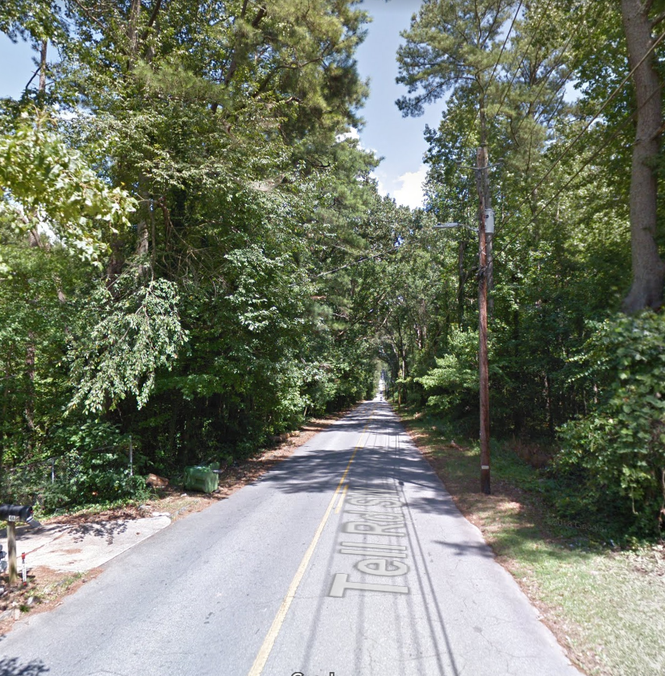
Ben Hill
Notes:
Tree canopy and ROW availability issues

Slide 13
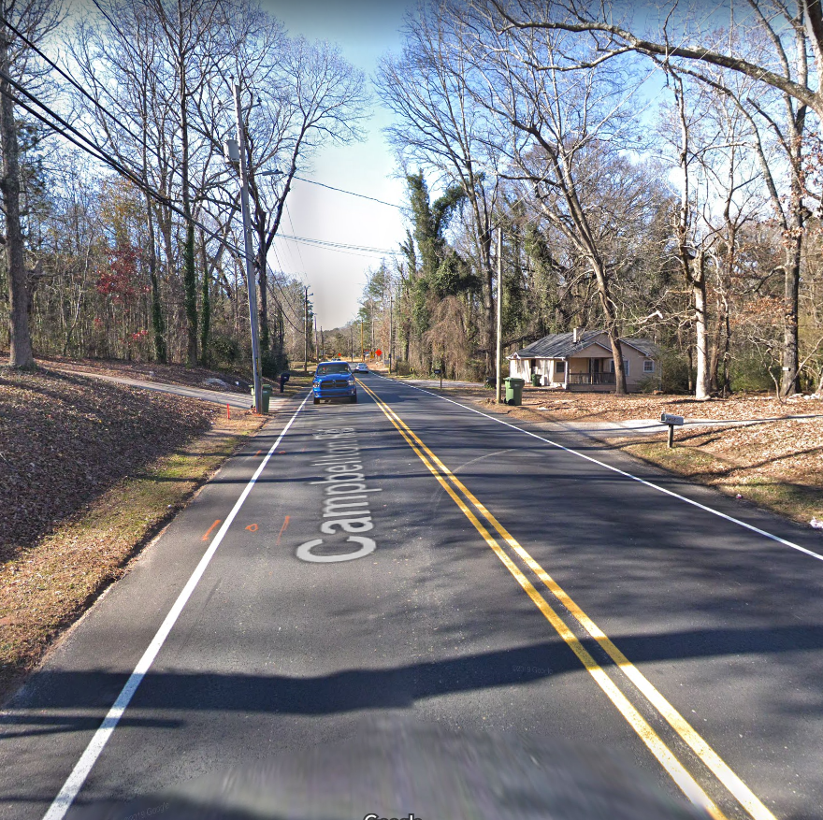
Ben Hill

Slide 14
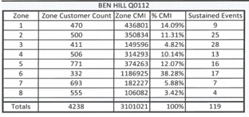
Ben Hill
Area is heavily treed with poles directly off the edge of pavement
Feeder #1: Convert approximately 50% of circuit to underground
5.6 miles of feeder cable and 2.6 miles of tap cable across the 8 zones
Expected reduction of 71% in customer minutes interrupted
Notes:
As seen on previous slides…

Slide 15
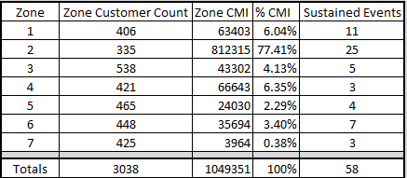
Ben Hill
Feeder #2: Convert 35% of the feeder to underground
Outages in zone 2 contribute 77% of the feeder’s customer minutes (trees and vehicles), entire section will be converted to underground
5.5 miles of feeder cable and 1.6 miles of tap cable converted to underground across the 7 zones
Expected reduction of 74% in customer minutes interrupted
Notes:
No trigger on %CMI to convert to UD…circuit by circuit look
The high % forced us to look at that segment and then we drilled down to outage root cause.
If there was a threshold, it would have been a low number because we have sunk a lot of $$ historically into these feeders on OH solutions.
Note: large circuits = more segments = smaller sections of line; if threshold was set, bias would be to smaller circuits with larger segments.

Slide 16
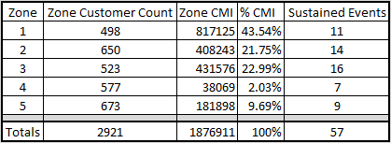
Ben Hill
Feeder #3: Convert 60% of the main line feeder to underground
3.3 miles of feeder cable and 0.7 miles of tap cable converted to underground across the 5 zones
Expected reduction of 79% in customer minutes interrupted
Notes:
Other improvements made to feeders: 1ph tap recloser installations and tree trimming

Slide 17
Ben Hill
This was the first project where vast sections of the feeder were converted to underground. Based on historical performance the last 20 years, it is warranted.
Also the first project where we designed our feeder cable and switchgear in our non-traditional fashion
With so many sections of underground feeding back to overhead, we experienced severe compression in our time-current coordination of protection devices
  Underground subdivisions and developments with interlaced protection systems and protection curves (switchgear fuses -> overhead fuses -> transformer fuses).
High number of padmounted switchgear in feeder cable system, replacement will be critical after failures
Lack of ROW for high number of padmounted switchgear
Notes:
Again, lots of OH solutions in the past have been used.
TCC notes: mixture of protection type and curves…swgr fuses, programmable vacuum interrupters, OH fuses, xfrmr fuses, etc

Slide 18
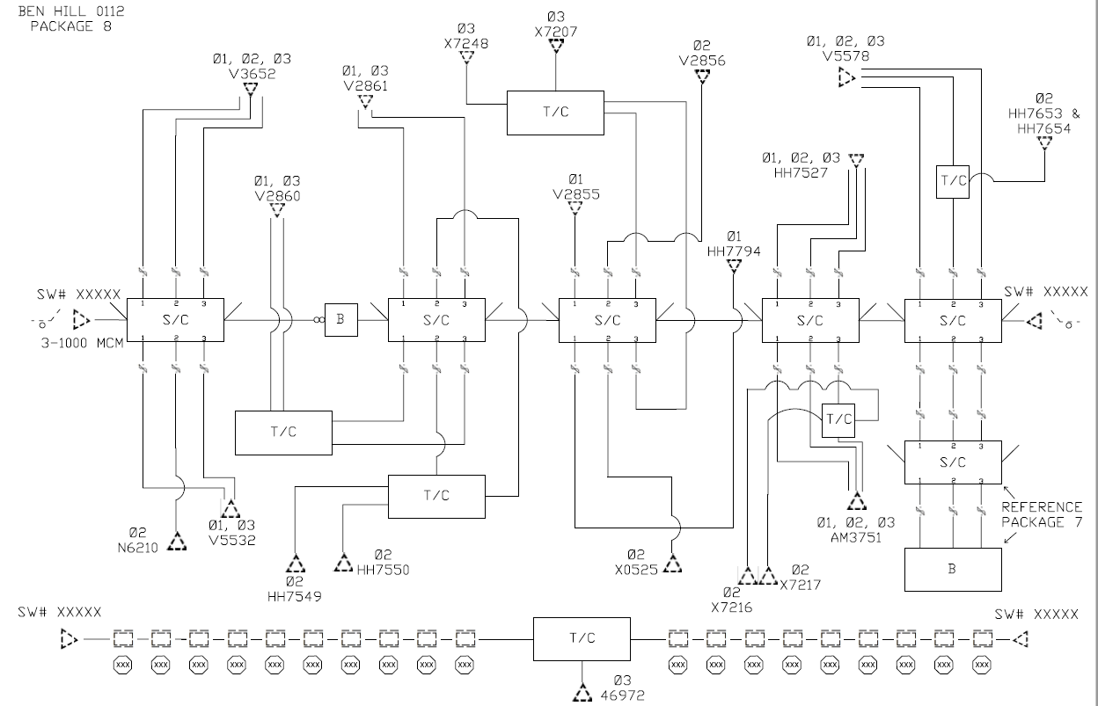
Ben Hill
Traditional overhead to underground design

Slide 19
Ben Hill
We went back to the first rule of reliability: define the feeder and protect it
Lower large equipment requirements (ROW requirements)
A single looped system between overhead protection devices seamlessly integrated
Intermix of protection types eliminated
Cable loading limitations carefully considered (both in normal and abnormal configurations)

Slide 20
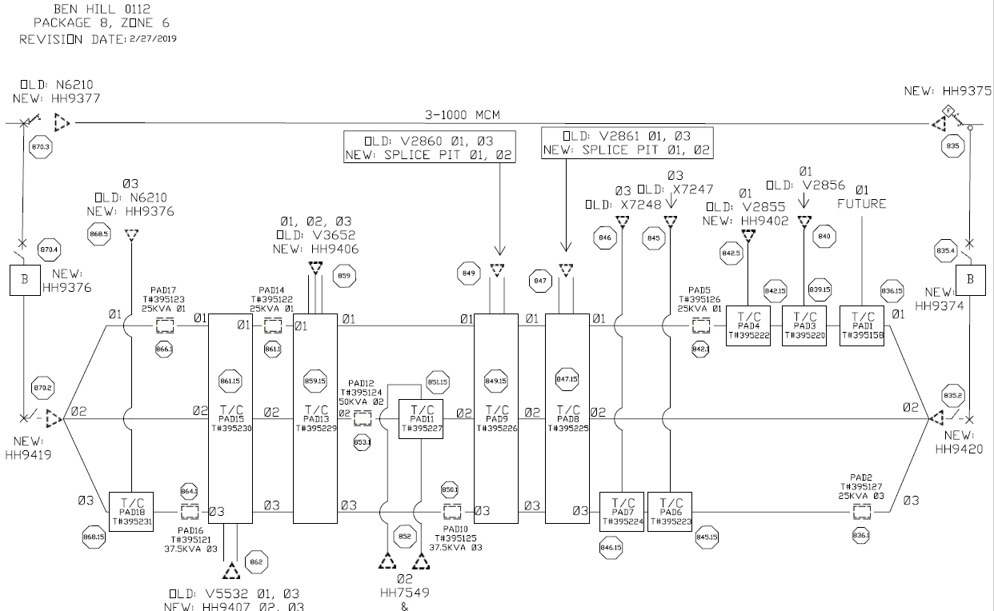
Ben Hill
text
Notes:
Decision based on TCC compression
Planning grade design with traditional design = X
Revised with non-traditional design = 1.5X
Traditional design also includes traditional construction methods and we are not use to multi-miles of OH/UD Conversions

Slide 21
Ben Hill
Expect to finish March 2020 (clean-up, OH removal)
Most of the new cable was energized by December 2019
16 month construction

Slide 22
Recap of Pilot Projects
Recap of pilot projects:
  Mystery Valley: OH to UD conversion for 10% of 3ph mainline (feeder)
  Roswell: 25% of 3ph mainline
  Ben Hill: 50% of 3ph mainline

Slide 23
Kirkwood
Proposed for Kirkwood:
  OH to UD conversion for 100% of multiphase primary (2ph or 3ph)
  Sectionalizing to 500 customers per segment
  Use DA devices to segment feeders
  1ph tap recloser installations
Notes:
Feeder cable design will be similar to Ben Hill, i.e. our non-traditional design. More switchgear on these projects because all the multi-phase is being converted to UD.

Slide 24
Kirkwood
20 kV system
2 feeders selected for pilot, each with 2000 customers
Both circuits are relatively short, opportunity to convert all multi-phase primary to UD.
  Feeder 1: 27 total miles / 17 OH, 10 UD / 6.1 multiphase to convert to UD
  Feeder 2: 16 total miles / 15 OH, 1 UD / 6.6 multiphase to convert to UD
Mostly residential area with associated small commercial

Slide 25
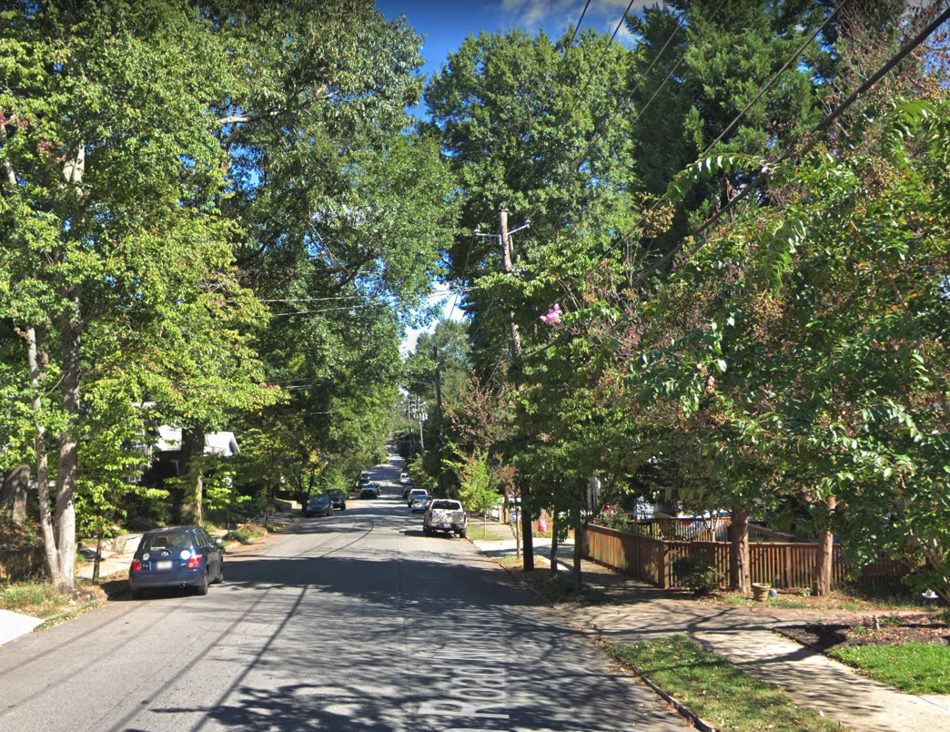
Kirkwood
Challenges:
Tree Canopy
Limited ROW
Traffic Congestion

Slide 26
Kirkwood
A true pilot to a Grid Investment Project.
Objectives desired:
  Gain insight into contract engineering
  Land acquisition
  Contractor / manpower resources
  Customer communications
  Material / Supply Chain
  Metro Atlanta construction challenges

Slide 27
Kirkwood
Historical reliability performance of 2 feeders
  Feeder 1: Statewide performance rank = 89
  Feeder 2: Statewide performance rank = 205
Estimated improvements:
  Feeder 1: 54% CMI reduction; 55% CE reduction
  Feeder 2: 63% CMI reduction; 49% CE reduction

Slide 28
Kirkwood
Estimate for both feeders:
  5 miles 3ph feeder cable
  36 miles of tap cable, configured in either 2ph or 3ph system
  29 mainline switching cubicles
    Sectionalize from feeder cable to tap cable and divide the feeder into 500 customer count segments

Slide 29
Kirkwood
Design and engineering is complete
Currently acquiring easements
Construction to start tentatively November 2019 in limited areas
  Property impact is significant
Plan to complete by end of 2020
  Currently lining up manpower for construction
Notes:
Touching every property owner
Communication and impact to customers / community unlike anything we’ve dealt with so far
Vast majority of construction is directional boring or hydro-vac
Both direct bury in bore and installation of roll conduit.

Slide 30
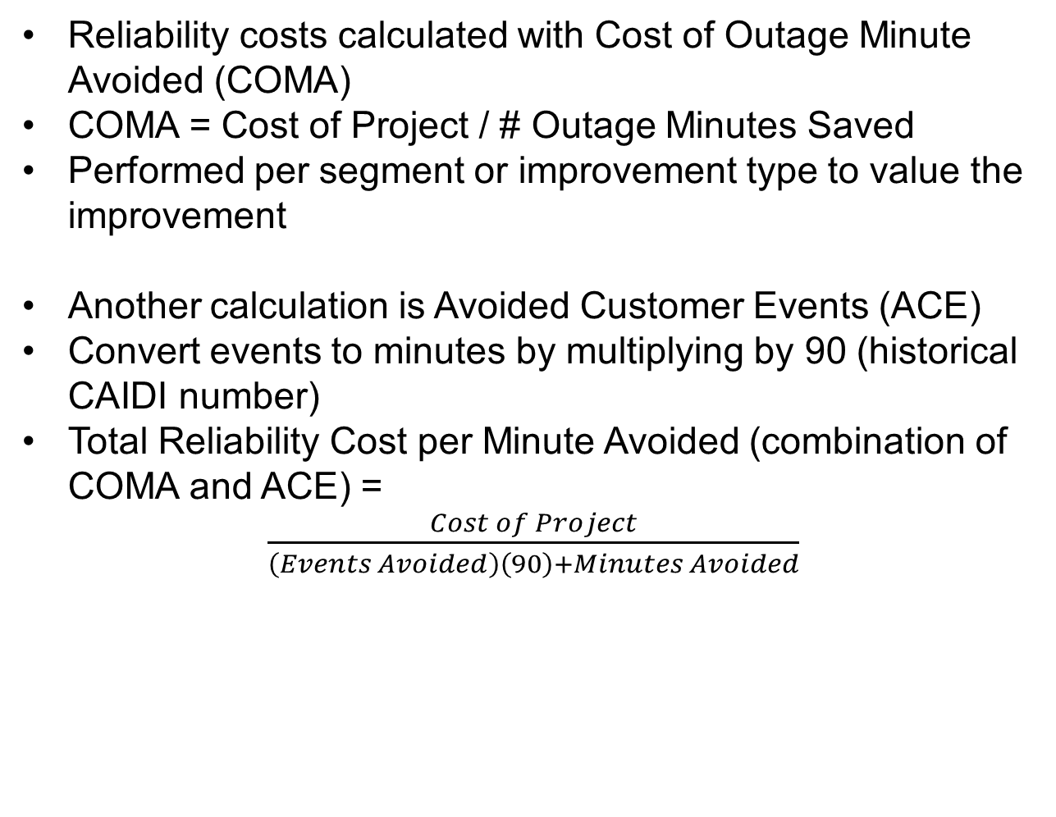
Conclusions
Reliability costs calculated with Cost of Outage Minute Avoided (COMA)
COMA = Cost of Project / # Outage Minutes Saved
Performed per segment or improvement type to value the improvement
Another calculation is Avoided Customer Events (ACE)
Convert events to minutes by multiplying by 90 (historical CAIDI number)
Total Reliability Cost per Minute Avoided (combination of COMA and ACE) =
  $\frac{Cost of Project}{\left(Events Avoided\right)\left(90\right)+Minutes Avoided}$
Notes:
Did not use ACE on Mystery Valley, Roswell, and Ben Hill. Other improvements were being made. We identified the segment then drilled down to root cause of how to solve.

Slide 31
Conclusions
Notes:
Initial estimate for Mystery Valley = X per mile
Kirkwood = 1.5 – 2 X per mile
Not all new design, we are still learning about all UD feeders.
Twice as many miles of UD cable, so any challenges with installation are magnified

Slide 32
Current Grid Investment Plan
Approved by GA Public Service Commission in December 2019, 3 year plan
$1B spend for distribution over 3 years
44 circuits to be converted to UD over three years
The proposed 12 year Grid Investment Plan touches 800 distribution circuits. 220 circuits are designated for OH to UD conversions (about 25%).
Cost wise, about 75% of the funds are designated for OH to UD conversions
Notes:
Grid Investment is all things we do today, just increased level of improvement
Philosophy shift from reliability maintenance to reliability improvement
Improvement types: segmentation (oh and ud), new ties (oh and ud), OH/UD conversions, strengthen existing ties, OH rebuilds (BIL improvements), 1ph reclosers on taps
OH/UD conversions will look like Kirkwood, all multiphase OH to convert to UD
Assumptions made on 800 circuits we are touching:
New SAIDI of 65; current number is 120+
Starting point was 85, further investigating of UD and performance of UD feeders got us to 65
For OH/UD conversions:
Bottom 2 quartiles circuit level SAIDI and SAIFI AND
Bottom quartile vehicle and tree events AND
Top 2 quartiles vegetation spending per mile MUST MEET ALL
220 out of 2600 meet all = 8%
Cost of outage minute saved:
If 65 is our new number, 60 mins saved x 2.5 M customers = 150 M minutes…$4.8 B / 150 M minutes = $32 / minute
Cost benefit analysis was ran to get to 800 circuits and different levels of investment. If did 600 circuits, lower cost but more outages. From a customer’s perspective cost of an outage (economical impact) + cost of Grid Investment (bill). Used DOE ICE calculator. Ran 16 models to achieve sweet spot on investment (economic cost and benefit).
Historical SAIDI and SAIFI: 2018=124/1.2; 2017=117/1.1; 2016=110/1.1

Slide 33
Thank You!
Notes:
Thank you!
Question?

